Slide 1
ENSE 470, Milestone 6
Team Covfefe
Taylen, Scott, and Jinpeng
March.29th

Slide 2
Executive summary
Technology used
  Database – MySQL
  PHP, HTML, JavaScript, CSS, AJAX
  Hosting - Hercules
User Story Map
  13 – Done, 3 from future releases moved to release 1
  1 – incomplete, moved to future release

Slide 3
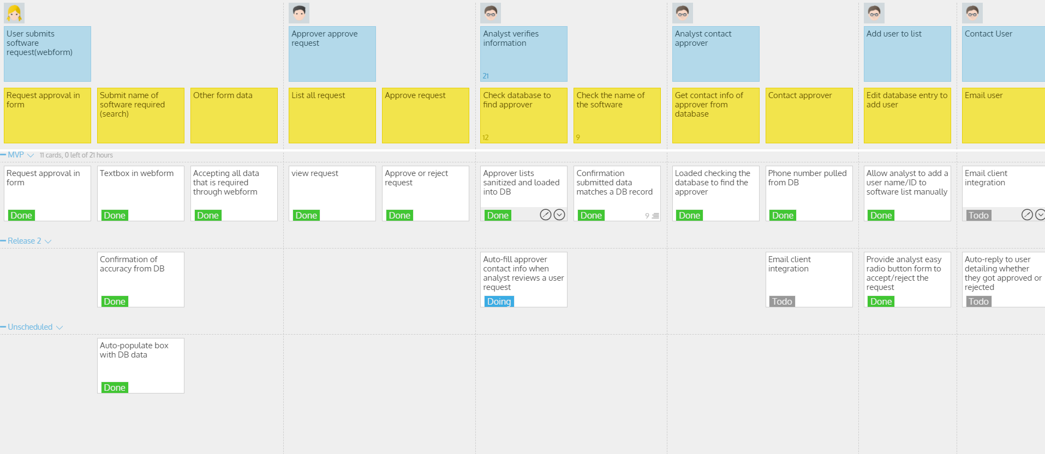
User Story Map Review

Slide 4
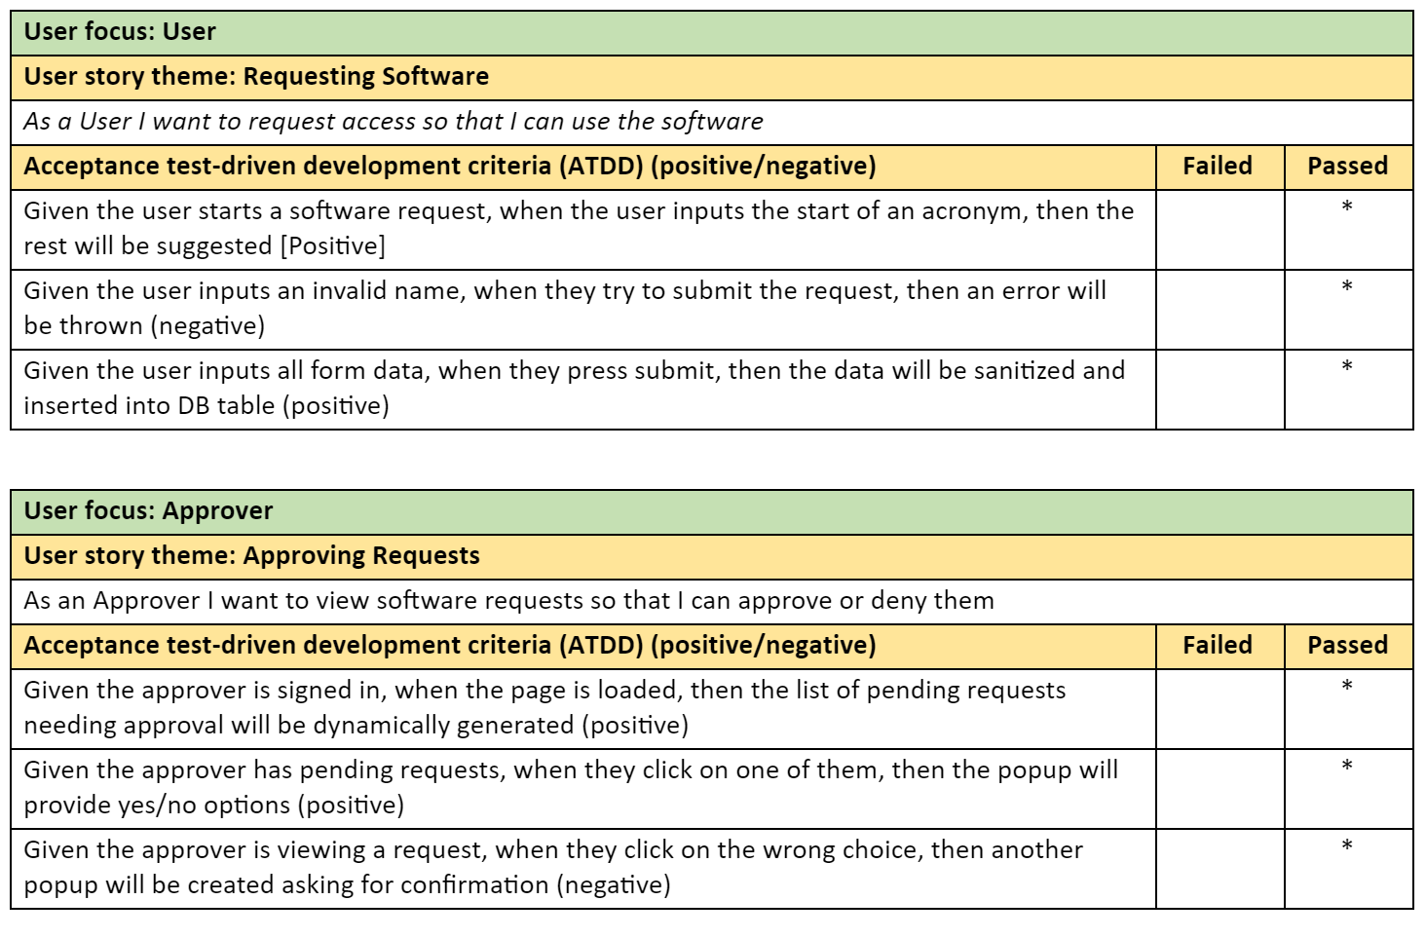
ATDD’s

Slide 5
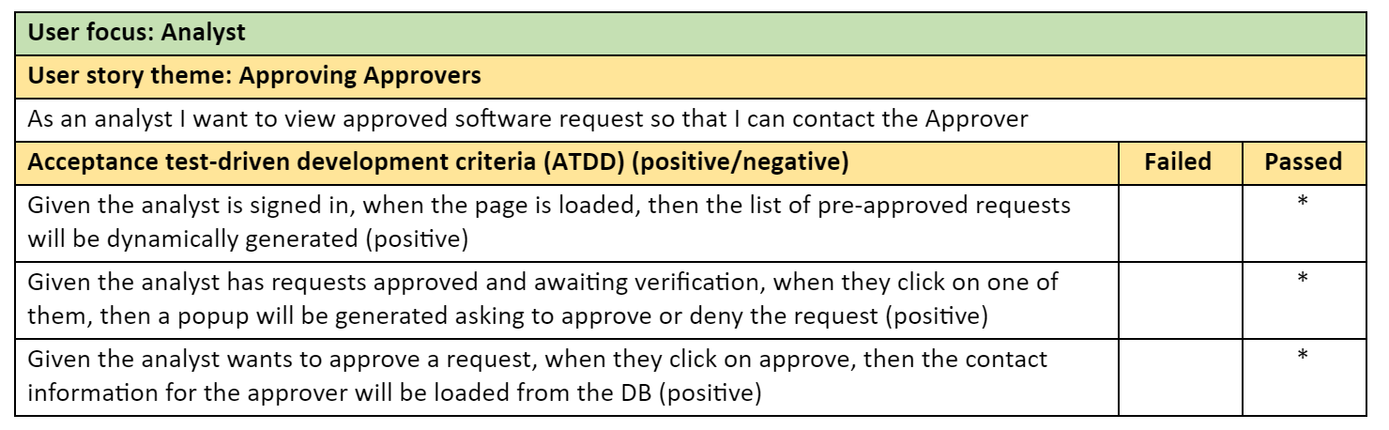
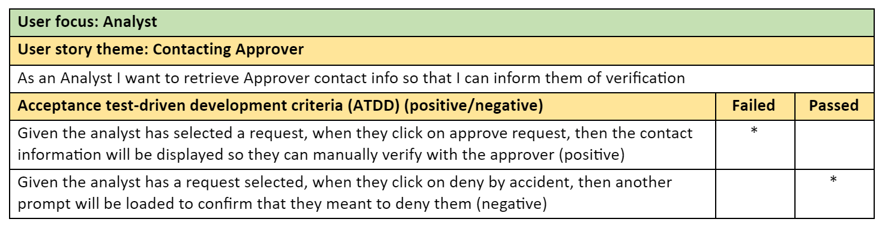
ATDD’s
*

Slide 6
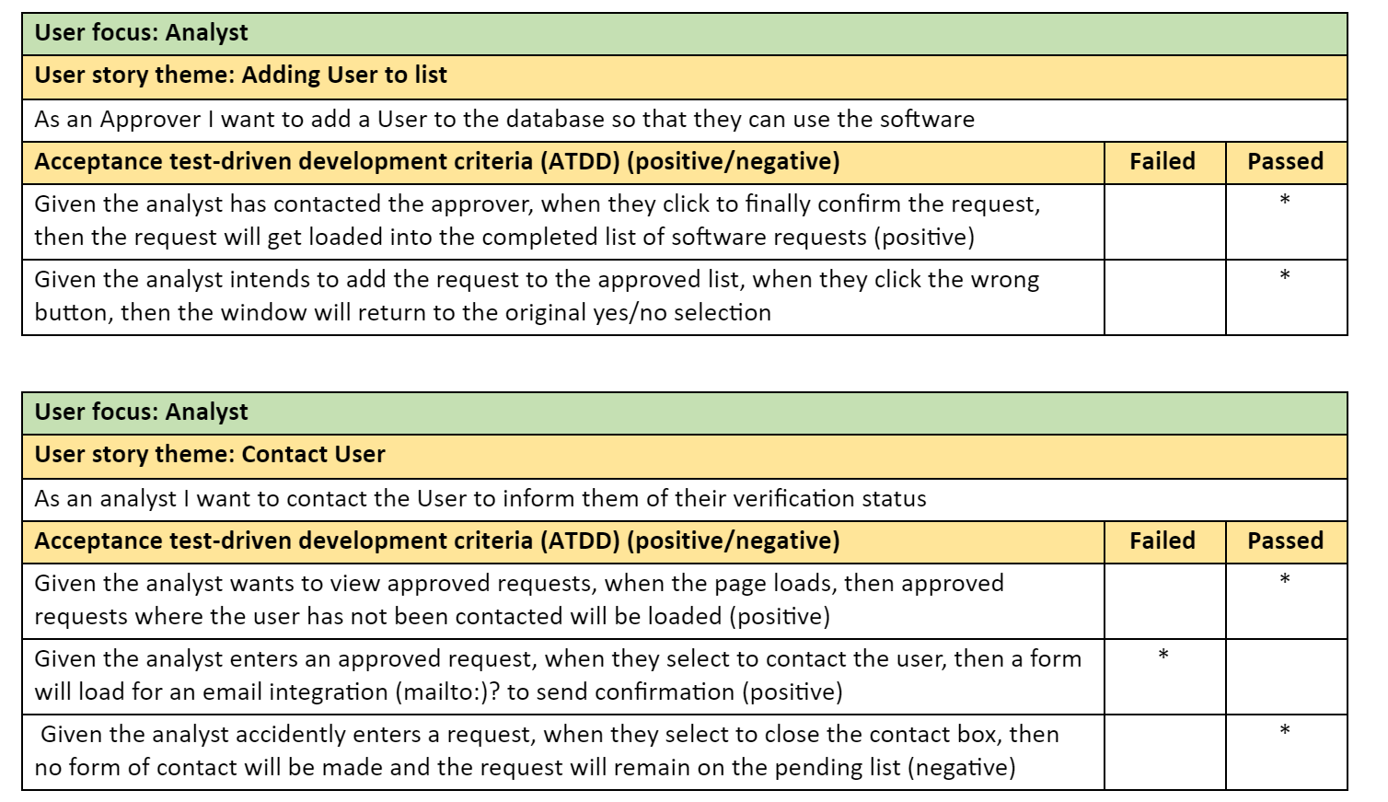
ATDD’s

Slide 7
Demo
http://www2.cs.uregina.ca/~thoma26s/ense470/splashpage.php
Design patterns used
  Façade
  Strategy
  Observer
  Composite

Slide 8
Group reflection
How did you feel about this milestone? What did you like about it? What did you dislike?
  Really good, because we’re finally done release 1
What did you learn about yourself as you collaborated and worked through this milestone?
  Nothing this time
How will you use what you have learned going forward?
  Be prepared for bugs to appear at any stage of development
What “stuff & things” related to this milestone would you want help with?
  Nothing we can think of

